Slide 1



Resume Integrity Checker: AI-Powered Fake Resume Detection
BATCH MEMBERS : FINAL YEAR
1) SHARMILA J (511321205033)
2) SOWMIYA G (511321205038)
3) SWETHA R (511321205044)
4) VANISRI R (511321205045)
Name of the Supervisor
Ms . S . SriLakshmi AP/IT

Slide 2
LITERATURE SURVEY
Title | Problem Statement | Algorithm | Features | Conclusion
Scalable Job Recommendation With Lower Congestion Using Optimal Transport Author : Bo Kyung Kang, and Tijl De Bie Year : 2024 | Accurately predicting personality traits, such as extroversion, from user-generated content is valuable for personalized services, recruitment, and career counseling. | Optimal Transport Algorithm | Uses an optimization-based approach to match candidates with job postings efficiently, reducing system overload. | We use an improved job recommendation model that optimizes candidate-job matching while reducing congestion and response time in large-scale recruitment systems.
AI Knows You: Deep Learning Model for Prediction of Extroversion Personality Trait Author : Anam Naz, Hikmat Ullah Khan, Sami , Omar Ibrahim Ali Daud, Muhammad Ramzan Year : 2024. | Accurately predicting personality traits, such as extroversion, from user-generated content is valuable for personalized services, recruitment, and career counseling | Bi-LSTM (Bidirectional Long Short-Term Memory) | User-generated content analyzed for linguistic Representations capturing semantic nuances of text Bi-LSTM model to process sequential data effectively. | The Bi-LSTM model utilizing sentence achieved high accuracy in predicting extroversion, outperforming existing studies in the relevant literature.

Slide 3

LITERATURE SURVEY
Title | Problem Statement | Algorithm | Features | Conclusion
Atypical responses of job candidates in chatbot job interviews and their possible triggers. AUTHOR: Helena Repova,Pavel Kral ,Jan Zouhar YEAR: 2024 | This paper aims to improve job recommendation systems by reducing congestion and improving matching accuracy. | Optimal Transport Algorithm | Uses an optimization-based approach to match candidates with job postings efficiently, reducing system overload. | We use an optimized job recommendation model that improves candidate-job matching while reducing congestion in large-scale recruitment platforms.
Mapping the Landscape of AI-Driven Human Resource Management: A Social Network Analysis of Research Collaboration Author: Yong .C Year:2020 | Explores how AI is reshaping HR management through research collaboration networks. | Social Network Analysis (SNA) | Analyzes AI-driven HR tools using graph-based models to map research trends. | We leverage SNA techniques to identify key AI advancements in HR, enhancing recruitment strategies.

Slide 4
LITERATURE SURVEY
Title | Problem Statement | Algorithm | Features | Conclusion
Online Recruitment Fraud (ORF) Detection Using Deep Learning Approaches Author:Omar Ibrahim Aboulola, Ali Daud Date:2020 | Aims to enhance job suitability prediction by using advanced NLP techniques. | Deep Learning (CNN, LSTM), Anomaly Detection (Isolation Forest, DBSCAN) | Uses deep learning and anomaly detection techniques to identify suspicious activities in online recruitment. | AI-powered fraud detection* to improve *security and trust in online hiring.
AI-Based Suitability Measurement and Prediction Between Job Description and Job Seeker Profiles Author: Yong Year:2020 | Aims to enhance job suitability prediction by using advanced NLP techniques. | TF-IDF, Word2Vec, BERT | Compares job descriptions with candidate resumes using deep learning for better job matching. | NLP models like BERT and Word2Vec to enhance resume-job suitability analysis, reducing manual effort.

Slide 5
LITERATURE SURVEY
Title | Problem Statement | Algorithm | Features | Conclusion
AI Knows You: Deep Learning Model for Prediction of Extroversion Personality Trait Author: Muhammad Year:2024 | Accurately predicting personality traits, such as extroversion, from user-generated content is valuable for personalized services, recruitment, and career counseling. | Bi-LSTM (Bidirectional Long Short-Term Memory) | User-generated content for linguistic patterns to Captures semantic nuances of text Bi-LSTM model processes sequential data effectively. | deep learning-based personality prediction to improve recruitment and career counseling, allowing better job role matching based on personality traits.
Assessing Intentional Resume Deception: Development and Network of a Resume Fraud Measure Authors: Christine A. Henle, Brian R. Dineen, Michelle K. Duffy Date: February 15, 2019 | Developing and validating a measure to empirically investigate intentional misrepresentations in resumes designed to mislead recruiters. | Gradient Boosting Classifier | Focuses on three dimensions of resume fraud: fabrication, embellishment, and omission. Explores the relationship between resume fraud and individual traits such as Machiavellianism and conscientiousness. | The study confirms a three-factor structure of resume fraud and provides evidence of construct validity, highlighting that resume fraud predicts reduced job performance and increased workplace deviance.

Slide 6
LITERATURE SURVEY
Title | Problem Statement | Algorithm | Features | Conclusion
Online Recruitment Services: Another Playground for Fraudsters Authors: Georgios Date: March 2016 | Investigating the characteristics and methods of online recruitment frauds and proposing automated detection mechanisms. | Fraud-BERT | Analysis of real-life fraudulent job advertisements. Proposal of detection mechanisms based on identified characteristics. | The study highlights the prevalence of fraud in online recruitment services and suggests that automated detection mechanisms can mitigate the risks posed to job seekers.
Fake Job Recruitment Detection Using Machine Learning Approach Authors: Sour Dutta Date: April 2020 | Developing a machine learning approach to detect fake job recruitments by analyzing job advertisements. | Random Forest (RF) Classifier | Utilizes encoding categories for text representation. Compares various machine learning classifiers and ensemble methods. | The Random Forest classifier delivered the best performance with an accuracy of 98.27%, indicating its effectiveness in detecting fake job recruitments.

Slide 7

ABSTRACT
The rise of online job applications has led to an increase in fake or manipulated resumes, making it essential to verify their authenticity.
This system leverages AI and machine learning to analyze resumes for inconsistencies, plagiarism, and falsified credentials.
It cross-checks information with publicly available data, company records, and professional networking platforms.
Optical Character Recognition (OCR) extracts and validates textual data from uploaded documents.
Natural Language Processing (NLP) identifies anomalies in experience, skills, and job history.
Machine learning models detect forged documents and mismatched details.
Cryptography technology can enhance security by storing verified credentials in an immutable format.
Employers can receive a reliability score for each resume, improving hiring efficiency.
This approach reduces hiring risks, prevents fraud, and ensures genuine candidate selection.

Slide 8

EXISTING SYSTEM
Job recommendation uses TF-IDF and rule based filtering which results in low accuracy in matching candidates with jobs.
Resume analysis relies on manual verification and keyword matching which makes fake resume detection inefficient.
Fraud detection uses K-Means Clustering and Naïve Bayes which are not effective for real time fraud detection.
Most existing systems (like basic ATS platforms) do not support scanned or image-based resume analysis.

Slide 9

PROPOSED SYSTEM
Job recommendation uses BERT and Optimal Transport Algorithm to improve job candidate matching.
Resume analysis implements Random Forest and CNN models to detect fake or manipulated resumes.
Fraud detection uses CNN, LSTM, and Isolation Forest to identify fake job postings and scams.
Hybrid Model (CNN + LSTM): Combines image and text analysis to detect both structural and content-based fraud.
Document forgery detection using image processing techniques (CV) to detect fake scanned documents.

Slide 10
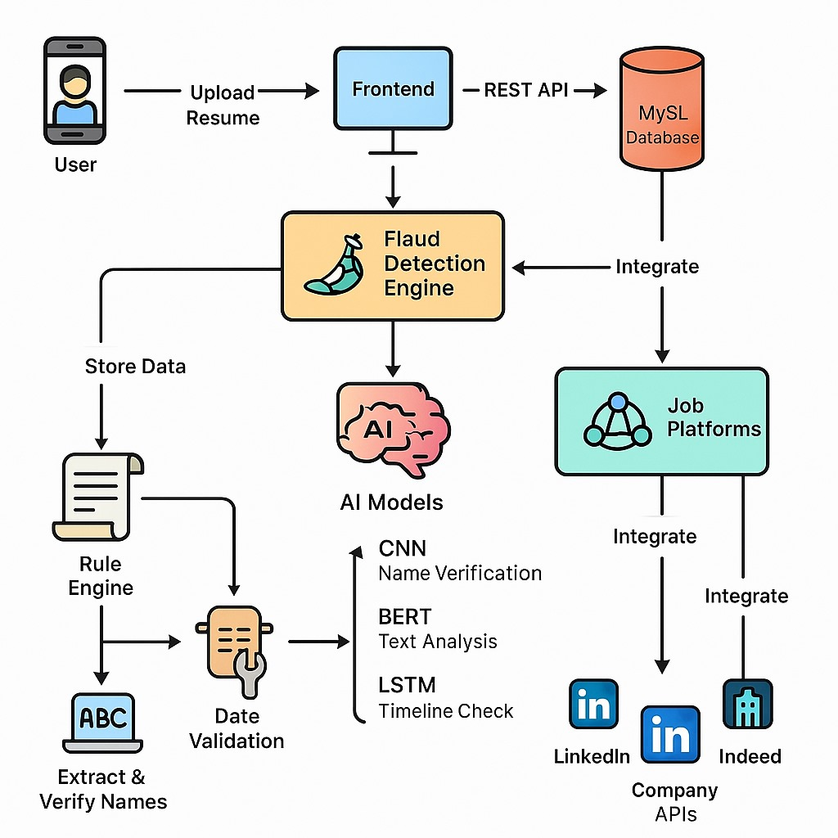
Architecture diagram

Slide 11

MODULES
Data Collection & Preprocessing Module
Gather and clean resume data Collect real & fake resumes from multiple sources text cleaning (removing special characters, numbers, word).Apply tokenization and lemmatization for structured textConvert text into numerical representation using TF-IDF, Word2Vec, or BERT
Tech Stack: Python, Pandas, NLTK.
Feature Extraction Module
Objective: Extract key resume features for fake detection.
Detection: Compare job role vs. experience.
Education Validation: Identify inconsistencies in degrees, universities
and certificate
Keyword Density Check: Identify overuse of technical keywords Grammar & Plagiarism Check: Use NLP-based models for text similarity detection.

Slide 12
MODULES
Model Training Module
Objective: Train ML/DL models to classify resumes as real or fake.
Select ML/DL models:
  Random Forest – for structured data features.
  CNN – for scanned document fraud detection.
  LSTM/BiLSTM – for sequential text analysis.
  Hybrid Model (CNN + LSTM) – to handle both structured & unstructured data.
Train models on the dataset and fine-tune hyperparameters.
Perform cross-validation and evaluate using accuracy, F1-score, ROC-AUC curve.
Tech Stack: TensorFlow, PyTorch, Scikit-learn, XGBoost

Slide 13
MODULES
Resume Verification Module
Objective: Validate details in the resume.
Cross-check resumes with LinkedIn/GitHub profiles (API-based validation).
Verify company names and job roles using online job databases (e.g., Glassdoor, LinkedIn).
Check for duplicate resumes using hash-based matching.
Tech Stack: Selenium, Web Scraping, PostgreSQL
Fraud Detection & Anomaly Detection Module
Objective: Detect fake resumes using anomaly detection techniques.
Implement Isolation Forest & Autoencoders to detect anomalies.
Use One-Class SVM to identify resumes with unrealistic data.
Detect copy-pasted job experiences & skills using NLP similarity measures.
Tech Stack: Scikit-learn, TensorFlow, Keras, Autoencoders

Slide 14
MODULES
User Interface (Web Portal) Module
Upload & scan resumes in PDF, DOCX, and image formats.
Display real-time fraud detection scores with insights.
Build a web-based interface for HR/recruiters.
Provide suggestions to HR on suspicious resumes.
Tech Stack: Html,Css, JavaScript, Flask, MySQL.
Deployment Module
Objective: Deploy the model and integrate with systems.
Build a REST API for third-party HR applications.
Monitor performance & feedback loop to improve detection.
Tech Stack: Docker, Kubernetes.

Slide 15

ALGORITHMS
Step 1: Data Collection
Gather resumes from various sources (job portals, company databases, etc.).
Include both real and fake resumes to ensure balanced learning
Store them in a structured format (e.g., JSON, CSV, or database).
Step 2: Data Preprocessing
Convert resumes into a uniform format (PDF to text if needed).
Remove noise such as special characters, headers/footers.
Normalize text (lowercasing, removing stop words, stemming/lemmatization).
For image-based resumes, convert images to grayscale or suitable format.

Slide 16
ALGORITHMS
Step 3: Feature Engineering
Extract important features (name, education, experience, skills, etc.).
Use NLP techniques (TF-IDF, word embeddings like Word2Vec, BERT). For images, use pixel-level or deep feature extraction methods (CNN-based).

Slide 17
ALGORITHMS
Step 4: Model Evaluation
Evaluate models using metrics such as accuracy, precision, recall, and F1-score.
Use cross-validation to test generalizability.
Analyze confusion matrix for error patterns (false positives/negatives).
Step 5: Deployment & Integration
Enable real-time processing of incoming resumes.
Ensure scalability and data privacy compliance (GDPR, etc.).

Slide 18

ALGORITHMS
Step 6: Model Selection & Training
CNN (Convolutional Neural Network):* Used for processing image-based resumes.
LSTM (Long Short-Term Memory):* Suitable for sequence modeling in text resumes.
Hybrid Model (CNN + LSTM):* Combines both models to handle structural and textual fraud detection effectively.* Train models using labeled datasets (real vs. fake).

Slide 19
EXPERIMENTAL RESULTS
Model Selection & Performance
CNN (Convolutional Neural Network): Used for detecting fraud in image-based resumes.
LSTM (Long Short-Term Memory): Effective for analyzing sequential textual data in resumes.
Hybrid Model (CNN + LSTM): Combines image and text analysis to detect both structural and content-based fraud.
Random Forest: Applied for structured data classification (e.g., keywords, education fields).
Evaluation Metrics: Models evaluated using Accuracy, F1-score, and ROC-AUC for comprehensive validation.

Slide 20

EXPERIMENTAL RESULTS
Fraud & Anomaly Detection
Isolation Forest & Autoencoders: Used to detect outliers and anomalies in resume data.
One-Class SVM: Identifies resumes with implausible or unrealistic data patterns.
NLP Similarity Techniques: Detects copy-pasted skills and job experiences.

Slide 21
EXPERIMENTAL RESULTS
Plagiarism & Grammar Checking
Utilizes NLP models to:
  Compare resume text similarity.
  Identify grammar inconsistencies.
  Check keyword stuffing in technical sections.

Slide 22
EXPERIMENTAL RESULTS
Data Preparation & Feature Engineering
Text Processing: Includes tokenization, lemmatization, and conversion using TF-IDF, Word2Vec, or BERT.
Feature Comparison: Checks alignment between claimed job roles, experience levels, and education backgrounds.

Slide 23
PERFORMANCE EVALUTION
Model Evaluation Metrics
Models are evaluated using accuracy, F1-score, and ROC-AUC curve.
These metrics help determine:
  How correctly the model identifies fake vs. real resumes (accuracy).
  The balance between precision and recall (F1-score).
  The trade-off between true positives and false positives (ROC-AUC).

Slide 24
PERFORMANCE EVALUTION
Comparison of Multiple Models
Several models are compared for effectiveness:
  Random Forest for structured data features.
  CNN for scanned document fraud detection.
  LSTM/ Bi LSTM for sequential text data.
  Hybrid Model (CNN + LSTM) to combine image and text fraud detection.

Slide 25
PERFORMANCE EVALUTION
Use of Hybrid Model
Combines the strengths of CNN and LSTM for multi-modal data (text + image).
Improves the overall detection accuracy and robustness.
Real-Time Scoring & Insights
System provides real-time fraud detection scores.
Offers detailed insights to HR on suspicious resume characteristics.

Slide 26
PERFORMANCE EVALUTION
Tech Stack for Evaluation
Includes:
  TensorFlow, PyTorch, Scikit-learn, XGBoost for modeling.
  These tools support scalable, efficient training and evaluation.
Tailor to the Role: Customize your resume to each job application, highlighting the skills most relevant to the specific position.
Be Specific: Mention job-relevant technical skills and tools you possess.
Use Action Verbs: Highlight accomplishments and demonstrate the impact of your tech skills.

Slide 27
COMPARSION WITH EXISTING SYSTEM
Feature | Special Feature | Existing System (from Literature) | Proposed System
Job Recommendation | Semantic understanding using BERT and Optimal Transport | TF-IDF and rule-based filtering | BERT + Optimal Transport Algorithm
Resume Analysis | Detects keyword stuffing, education & experience mismatches | Manual checks, keyword matching | Random Forest + CNN + NLP
Fraud Detection | Real-time fraud and fake job posting detection | K-Means, Naïve Bayes | CNN, LSTM, Isolation Forest
Plagiarism Detection | Detects paraphrased content using NLP & grammar models | Basic keyword overlap | NLP-based similarity + grammar check
Resume Verification | API-based cross-check with LinkedIn, GitHub | No automated verification | API validation with external sources

Slide 28

S .No | Real resume | Fake resume | probability | comments
1 | Sowmiya-resume.pdf | - | 25 | Strong Performer
2 | - | Fake _resume.pdf | 75 | Confusing flow
3 | sharmi_-pdf | - | 21 | Highly motivated
4 | Vani-img | - | 15 | Result driven
5 | - | Fake_resume_24.pfd | 80 | Bad formatting
6 | - | Resume_fake_4.pdf | 70 | Unrelavent
7 | Swetha.pdf | - | 17 | accomplished
8 | gayatri.img | - | 20 | proficient
9 | - | Fake_resume_29.pdf | 82 | Generic Resume
10 | - | Fake_resume_2.pdf | 74 | excessive details

Slide 29
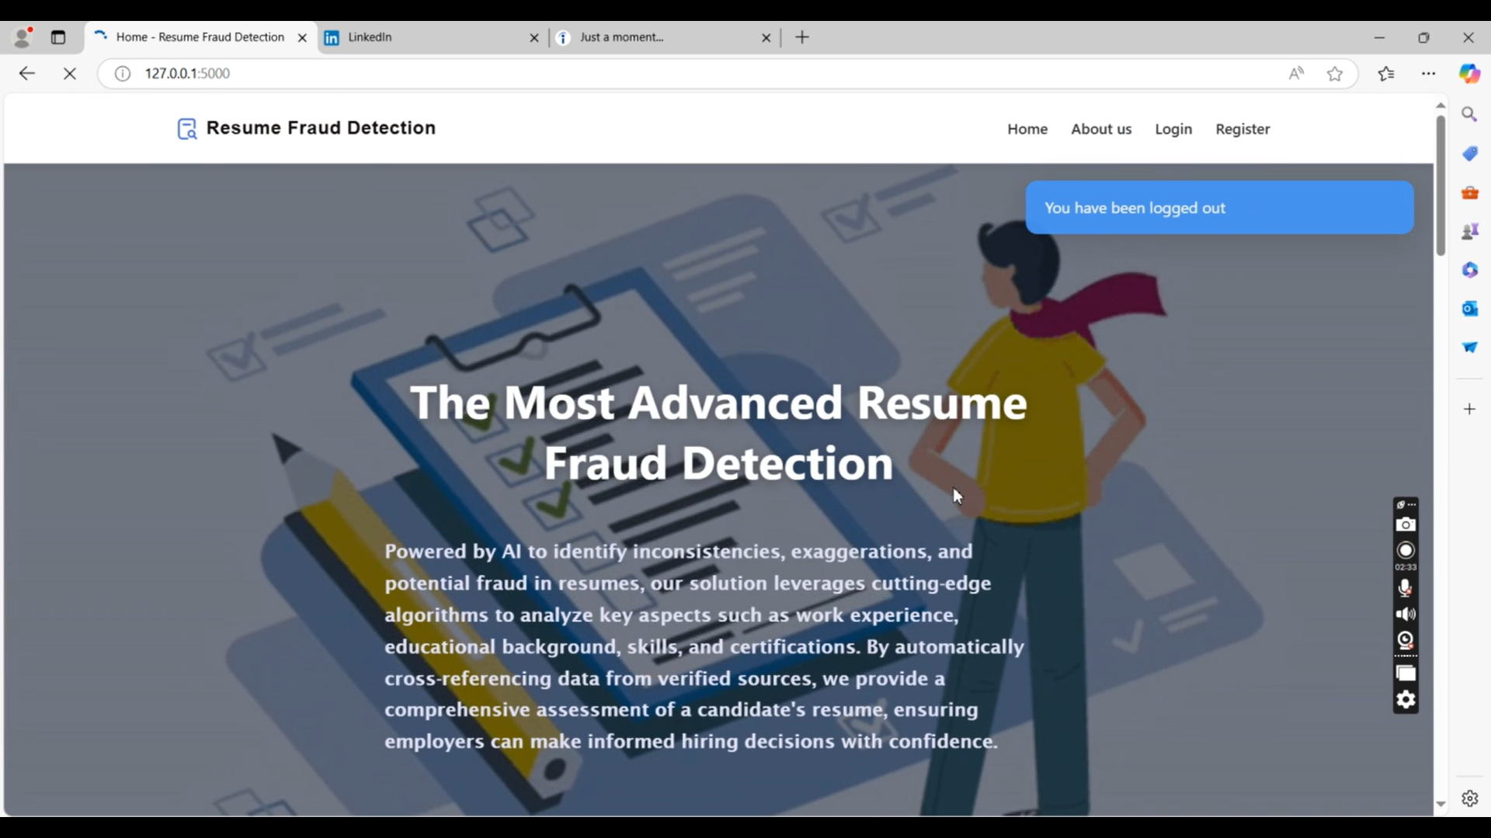
RESULTS

Slide 30
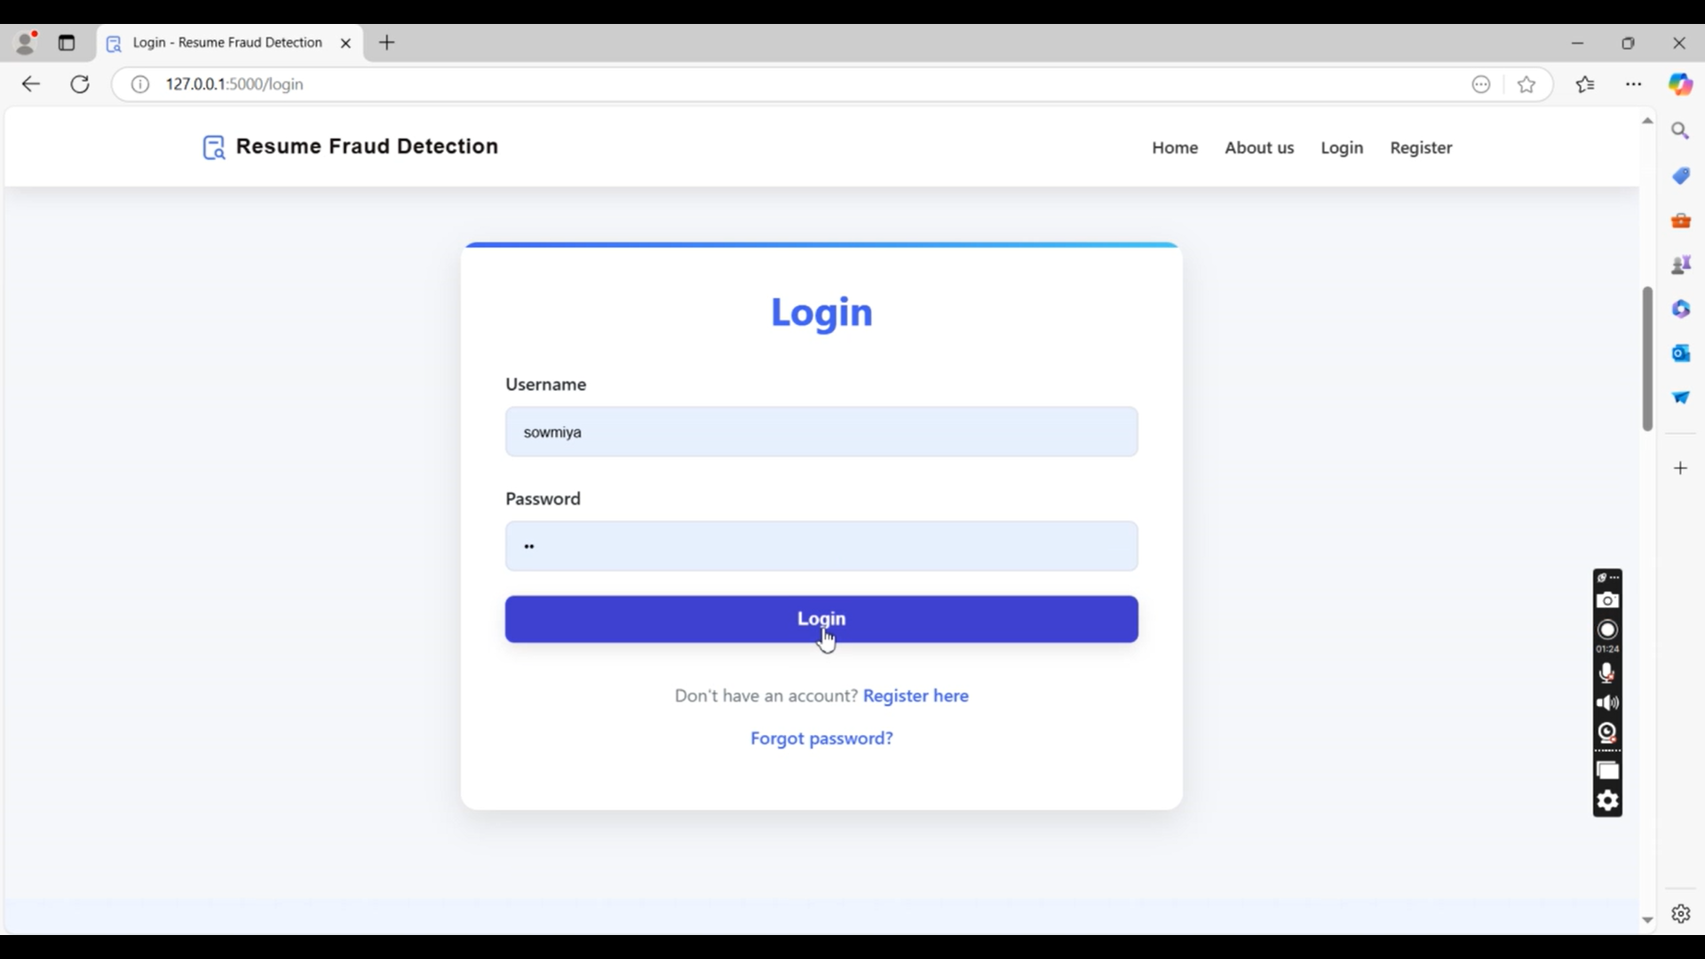


Slide 31
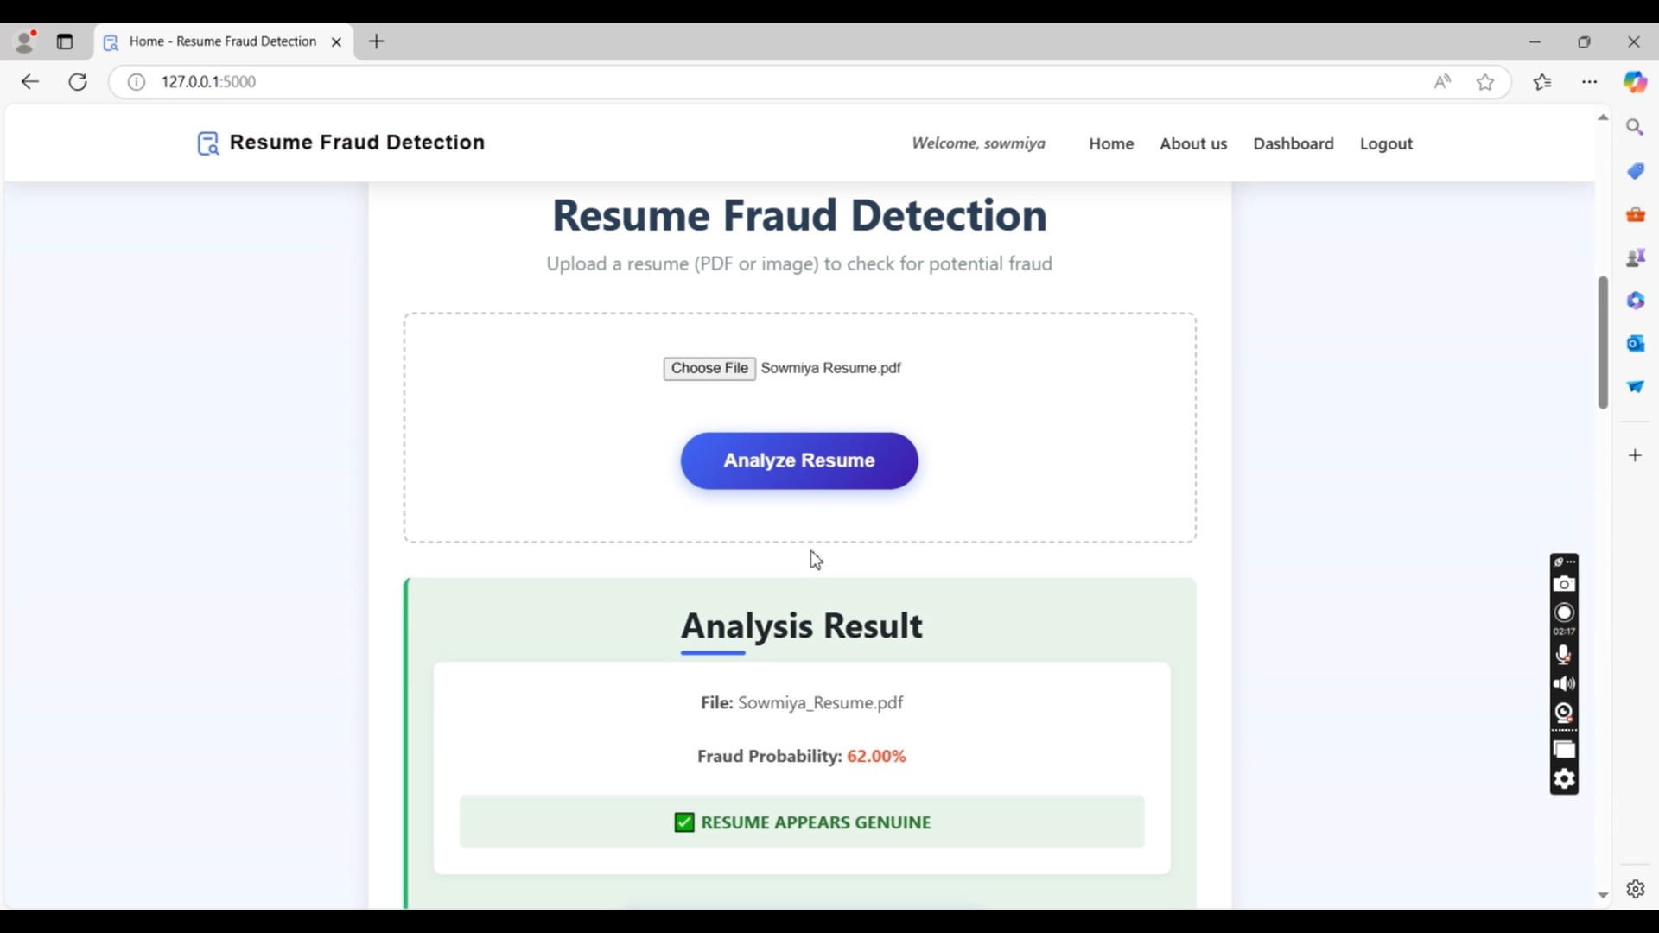

Slide 32
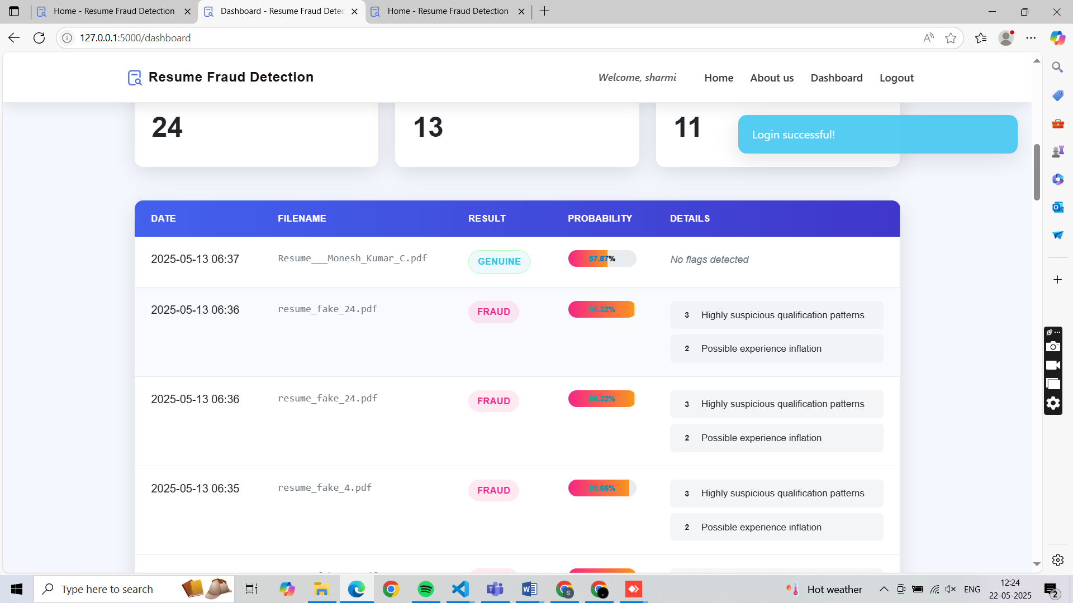

Slide 33
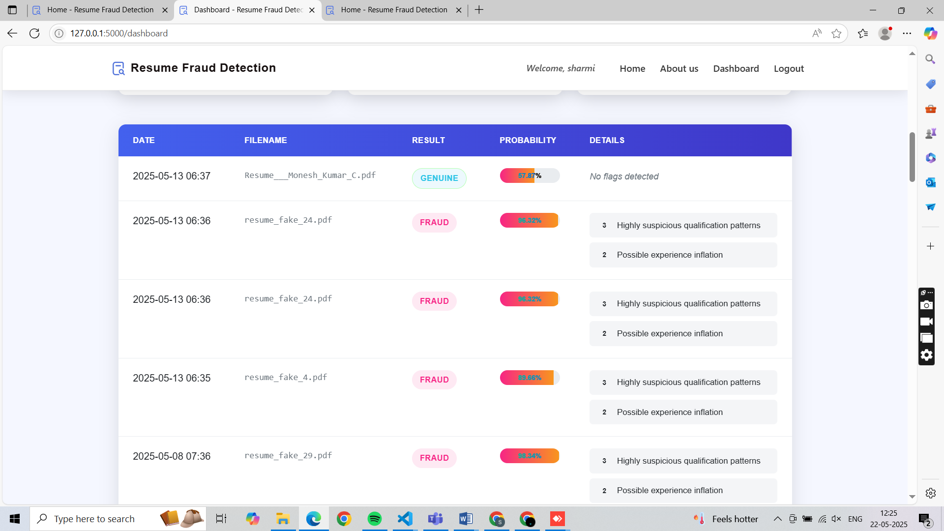

Slide 34
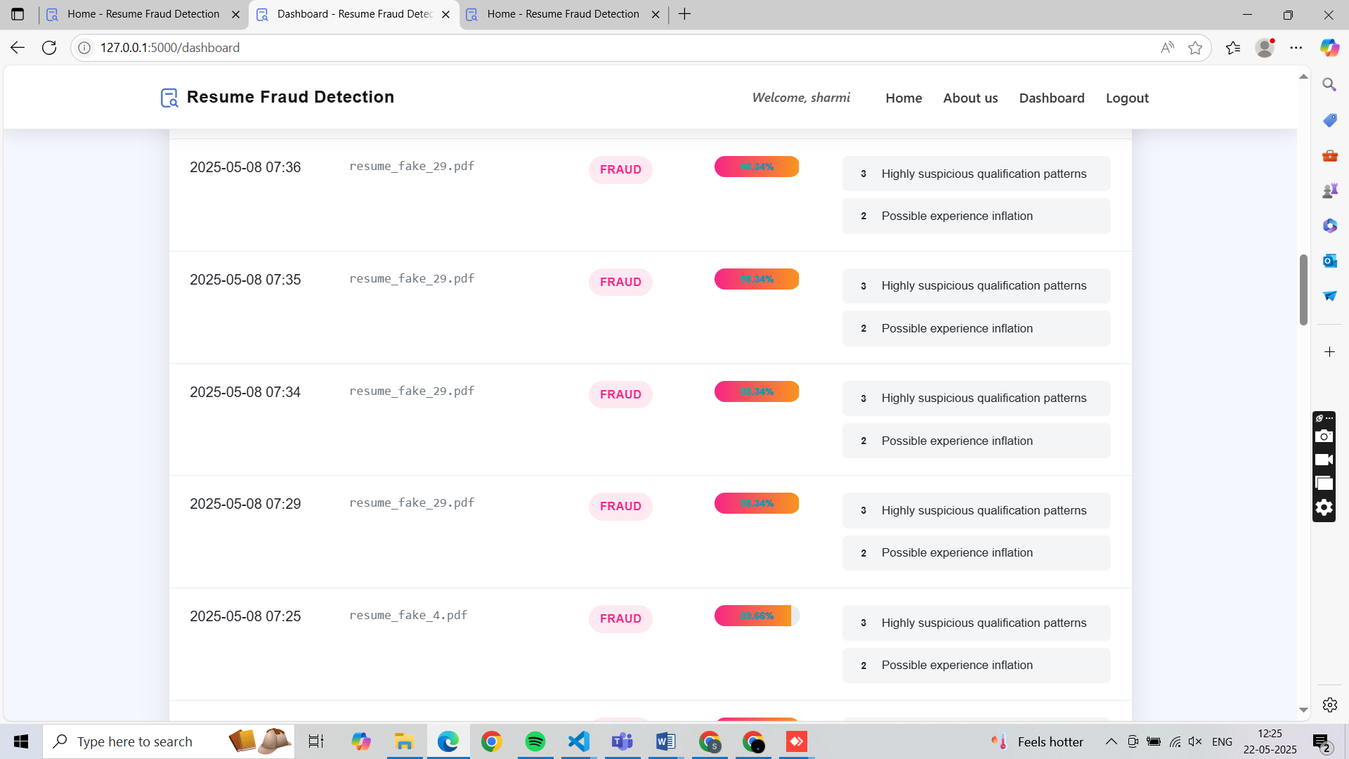

Slide 35
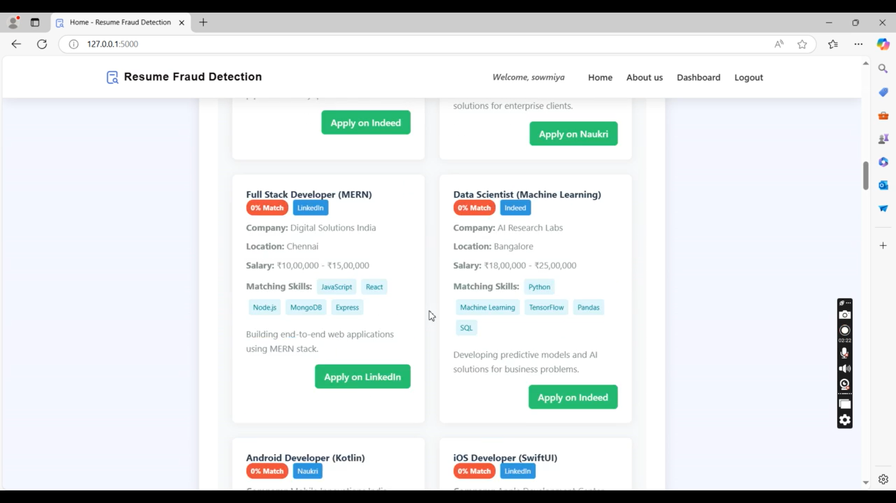

Slide 36

references
Agarwal, A., Beygelzimer, A., Dudik, M., Langford, J., & Wallach, H. (2018). A Reductions Approach To Fair Classification. Proceedings Of Machine Learning Research, 80, 60-69.
Anderson, N. (2003). Applicant And Recruiter Reactions To New Technology In Selection. International Journal Of Selection And Assessment, 11(2-3), 121-136. Https://Doi.Org/10.1111/1468-2389.00235
Arneson, R. (2016). Does Fairness Require A Multidimensional Approach? Oxford Handbook Of Wellbeing And Public Policy, 588-614.

Slide 37
references
Barocas, S., & Selbst, A. D. (2016). Big Data's Disparate Impact. California Law Review, 104, 671-732.
Bartone, P. T., & Bowles, S. V. (2020). Coping With Recruiter Stress. Military Psychology, 32(5), 390-397.
Dastin, J. (2018). Amazon Scraps Secret Ai Recruiting Tool. Reuters. Https://Www.Reuters.Com/Article/Us-Amazon-Com-Jobs-Automation-Insight-Iduskcn1mk08g

Slide 38
THANK YOU

